Slide 1

DAE PROJECT:
Social Media Data Analysis System
FINAL PPT: | YouTube Trending Analytics Dashboard
Team Members
M. Sahithi (25B11CS581)
C. Lahari (25B11CS168)
P. Yaswanth (25B11CS754)
K. Lokesh (25B11CS434)
Notes:
Good morning. We are presenting Review-2 of our DAE project: the Social Media Data Analysis System, built on YouTube trending videos. Introduce the four team members.

Slide 2

Recap of Review-1
The project
A data analytics system that analyzes YouTube trending videos to show what drives content to trend: top categories, countries and channel types.
Problem
Trending video data is huge and hard to interpret manually. Views, likes, comments and duration are difficult to compare across videos.
Proposed solution
An automated pipeline (Load, Clean, Transform, Visualize) in Python with Pandas and NumPy, and an interactive Streamlit dashboard for creators, marketers and analysts.
Data used
youtube_large_dataset.xlsx (sheet "Data"): title, channel, channel tier, category, country, views, likes, comments, duration, publish and trending dates.
DAE • Review-2 • Social Media Data Analysis System
2
Notes:
Quick recap of Review-1: trending data is huge and hard to compare by hand. Our solution is an automated pipeline (load, clean, transform, visualize) with an interactive Streamlit dashboard.

Slide 3
Implementation Pipeline and Modules Completed
1 Load
2 Clean
3 Transform
4 Filter
5 Visualize
6 Insights
6 Insights
Module | What it does | Status
Data Loading | Reads youtube_large_dataset.xlsx (sheet "Data") using Pandas | Done
Data Cleaning | Standardises names, removes duplicates, fixes types and missing values | Done
Transformation | Adds engagement_rate, like_rate, log10_views and trend_month | Done
Filters and Sorting | Search, tier, category, country, view-range filters; sort and top-N | Done
Dashboard (Streamlit + Plotly) | KPI cards, bar / pie / line charts, sorted table, CSV download, insights | Done
Testing and report | Checking outputs with different filters and writing the final report | Done
Done
DAE • Review-2 • Social Media Data Analysis System
3
Notes:
These are the six steps of the pipeline and the modules we finished. Everything is done except final testing and the report. Steps 1 to 3 run inside the clean() function every time the app starts.

Slide 4
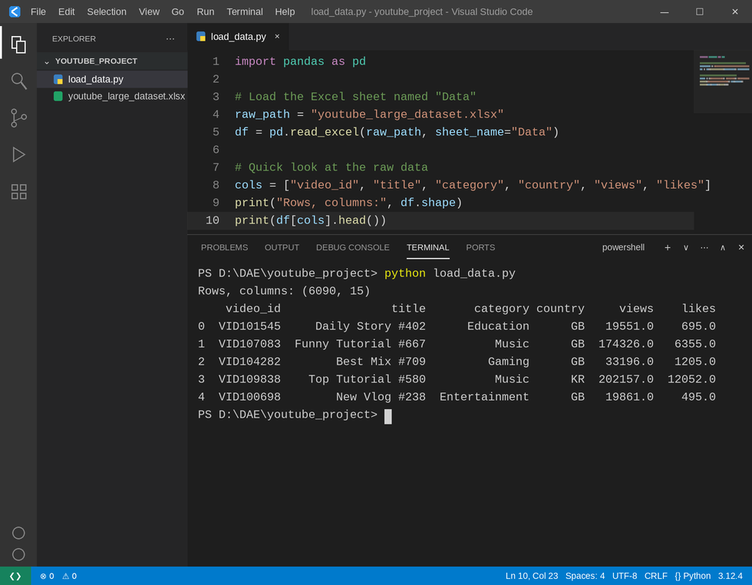
Module 1: Data Loading
SAMPLE OUTPUT
Data loaded
Video id, title, channel, channel tier
Category and country
Views, likes, dislikes, comments
Duration, days to trend, dates
# Load the Excel sheet named "Data"
df = pd.read_excel(raw_path, sheet_name="Data")
Tools used
Pandas (load, clean), NumPy (median, log10), Plotly (charts), Streamlit (dashboard)
DAE • Review-2 • Social Media Data Analysis System
4
Notes:
Module 1 loads the Excel sheet named Data with one Pandas line. The screenshot is VS Code running load_data.py: 6,090 rows and 15 columns. The blanks and negative values in the raw file are why cleaning is needed.

Slide 5
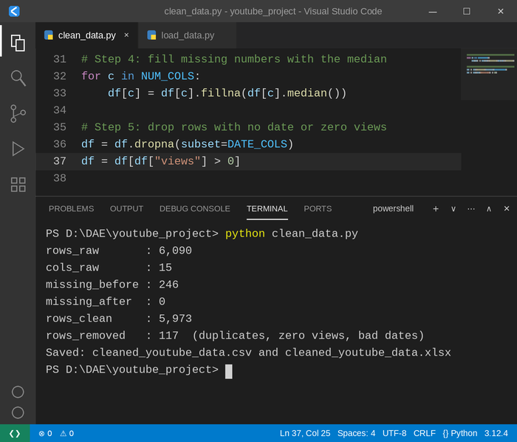
Module 2: Data Cleaning (Steps 1 to 5)
# Step 1: tidy column names, drop empty columns
df.columns = (df.columns.str.strip()
.str.lower().str.replace(" ", "_"))
df = df.dropna(axis=1, how="all")
# Step 2: remove duplicate rows and duplicate videos
df = df.drop_duplicates().drop_duplicates(subset="video_id")
# Step 3: make numbers numeric, dates real dates
for c in NUM_COLS:
df[c] = pd.to_numeric(df[c], errors="coerce")
df.loc[df[c] < 0, c] = np.nan # negative = invalid
for c in DATE_COLS:
df[c] = pd.to_datetime(df[c], errors="coerce")
# Step 4: fill missing numbers with the median
for c in NUM_COLS:
df[c] = df[c].fillna(df[c].median())
# Step 5: drop rows with no date or zero views
df = df.dropna(subset=DATE_COLS)
df = df[df["views"] > 0]
SAMPLE OUTPUT
Result: duplicates and invalid rows are removed, and 0 missing values remain.
DAE • Review-2 • Social Media Data Analysis System
5
Notes:
Walk through the green comments one by one: tidy column names, remove duplicates, convert types, fill missing numbers with the median, drop rows with no date or zero views. The terminal shows the cleaning log.

Slide 6
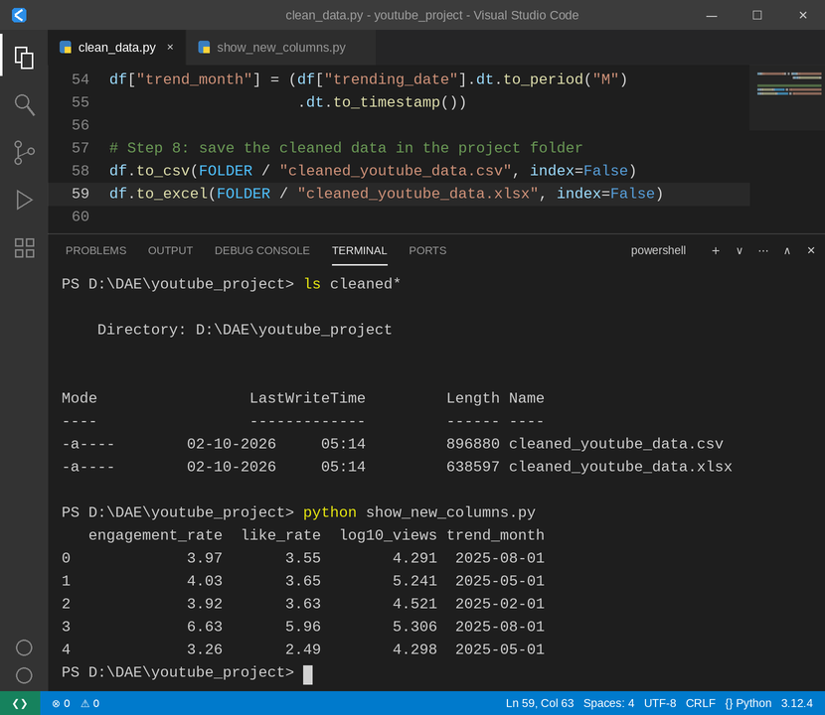
Module 3: Validation, New Columns and Saving
# Step 6: logical fixes
# likes, dislikes, comments can never be more than views
for c in ["likes", "dislikes", "comment_count"]:
df[c] = df[c].clip(upper=df["views"])
# a video cannot trend before it was published
df = df[df["trending_date"] >= df["publish_date"]]
# Step 7: new columns used by the dashboard
# engagement % = (likes + comments) / views
df["engagement_rate"] = ((df["likes"] + df["comment_count"])
/ df["views"] * 100).round(2)
df["like_rate"] = (df["likes"] / df["views"] * 100).round(2)
# log scale so viral videos do not hide small ones
df["log10_views"] = np.log10(df["views"]).round(3)
# month of trending, used by the line chart
df["trend_month"] = (df["trending_date"].dt.to_period("M")
.dt.to_timestamp())
# Step 8: save the cleaned data in the project folder
df.to_csv(FOLDER / "cleaned_youtube_data.csv", index=False)
df.to_excel(FOLDER / "cleaned_youtube_data.xlsx", index=False)
SAMPLE OUTPUT
Result: 4 new columns are added and both cleaned files are saved.
DAE • Review-2 • Social Media Data Analysis System
6
Notes:
Step 6 fixes impossible values (likes above views, trending before publish). Step 7 creates engagement_rate, like_rate, log10_views and trend_month. Step 8 saves the cleaned CSV and Excel files in the project folder.

Slide 7
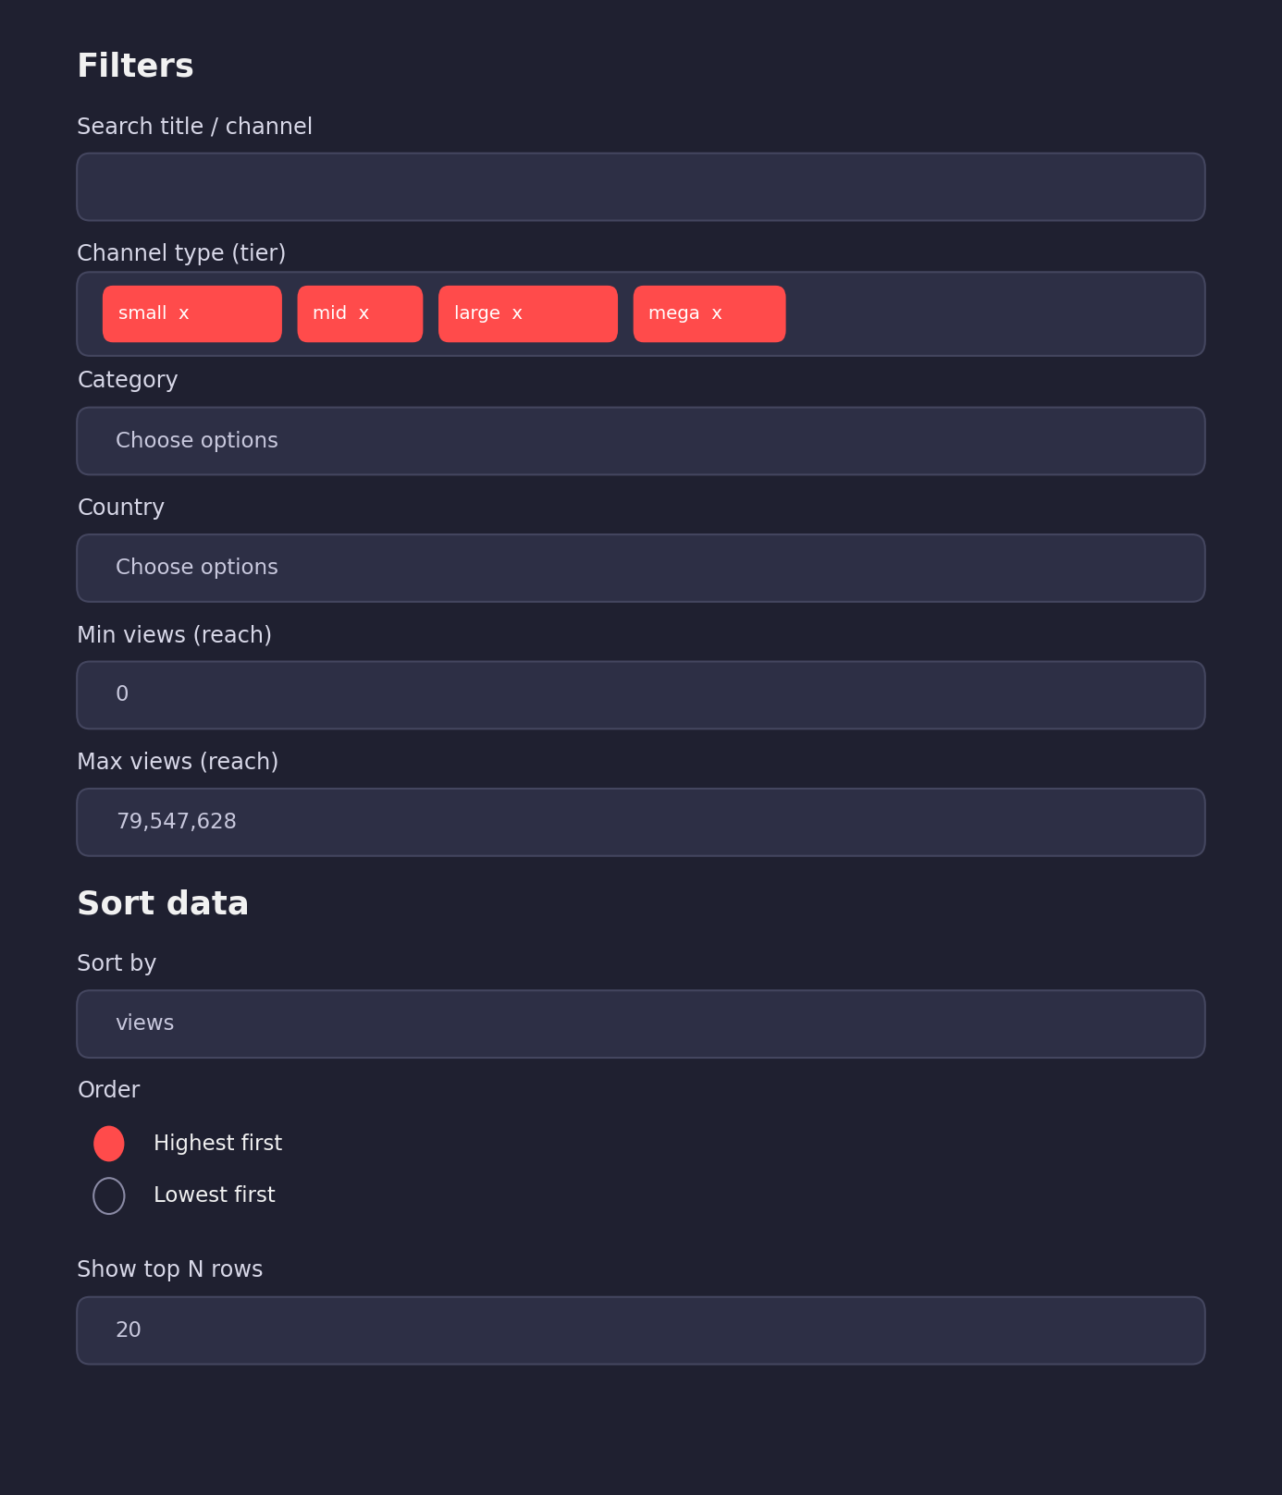
Module 4: Dashboard Filters and Sorting
# Sidebar widgets: the user's choices
tiers = st.sidebar.multiselect(
"Channel type (tier)", TIERS, default=TIERS)
cats = st.sidebar.multiselect(
"Category", sorted(df.category.unique()))
min_views = st.sidebar.number_input(
"Min views (reach)", 0, int(df.views.max()), 0)
# Keep only the rows that match the choices
f = df[df.channel_tier.isin(tiers)
& df.views.between(min_views, max_views)]
if cats: # category filter (only if chosen)
f = f[f.category.isin(cats)]
if search: # search in title or channel name
f = f[f.title.str.contains(search, case=False)
| f.channel_title.str.contains(search, case=False)]
SAMPLE OUTPUT
Result: every KPI and chart updates as soon as a filter changes.
DAE • Review-2 • Social Media Data Analysis System
7
Notes:
The sidebar lets the user filter by channel tier, category, country, view range and text search, then sort. The filters build the table f, and every KPI and chart is drawn from f, so they all update together.

Slide 8
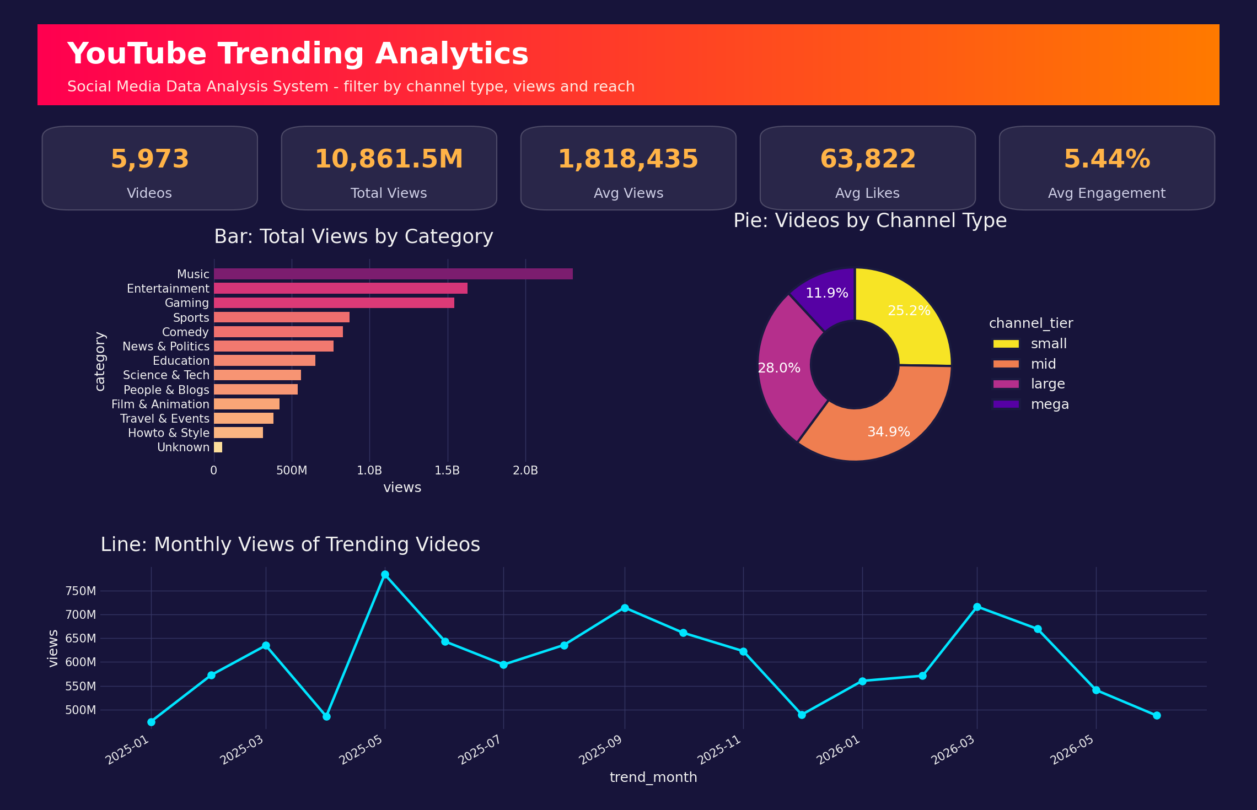
Dashboard Overview and KPI Cards
SAMPLE OUTPUT
# KPI cards: summary numbers
# that follow the filters (f)
kpis = [
("Videos", f"{len(f):,}"),
("Total Views",
f"{f.views.sum()/1e6:,.1f}M"),
("Avg Views",
f"{f.views.mean():,.0f}"),
("Avg Likes",
f"{f.likes.mean():,.0f}"),
("Avg Engagement",
f"{f.engagement_rate.mean():.2f}%"),
]
# draw one card for each KPI
for col, (name, val) in zip(
st.columns(5), kpis):
col.markdown(card_html)
DAE • Review-2 • Social Media Data Analysis System
8
Notes:
This is the full dashboard. The five KPI cards (videos, total views, average views, average likes, average engagement) are calculated from the filtered data.

Slide 9
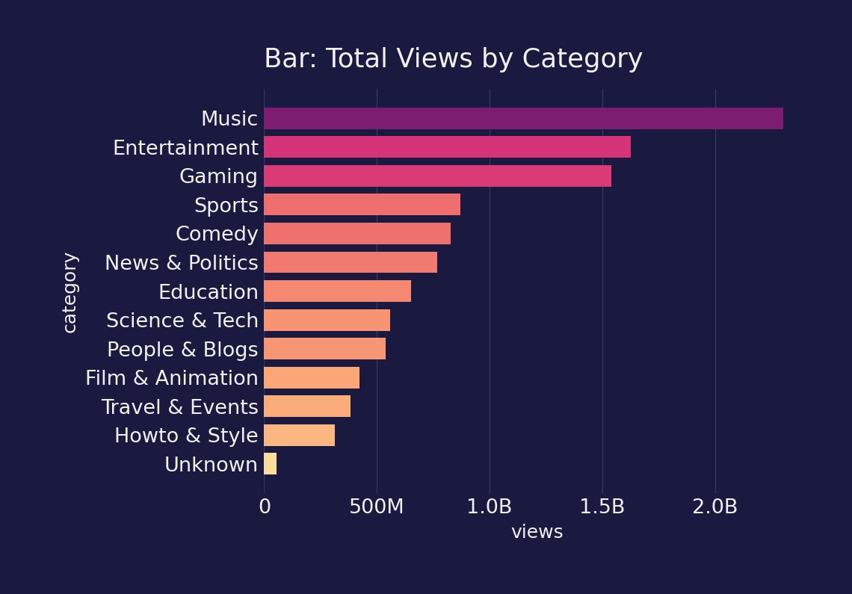
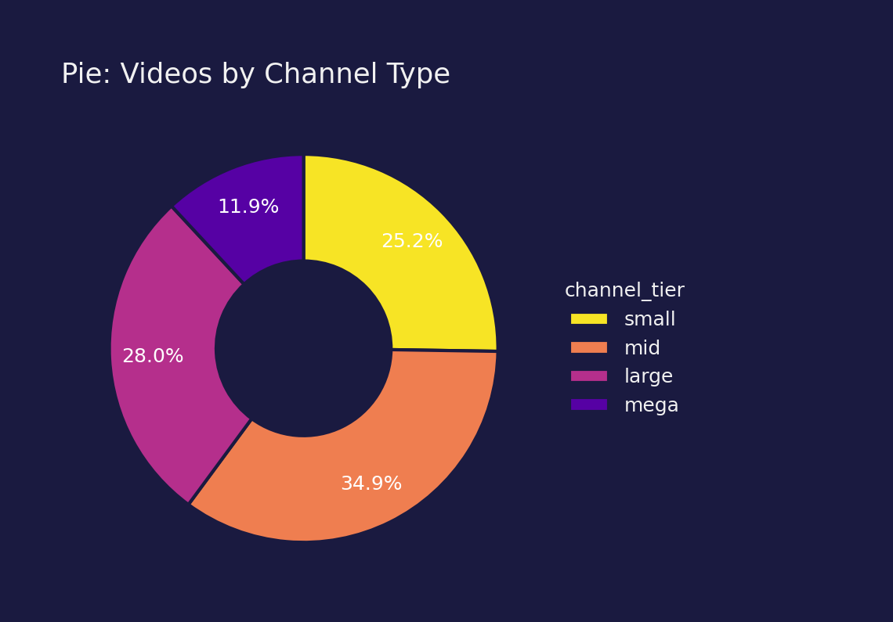
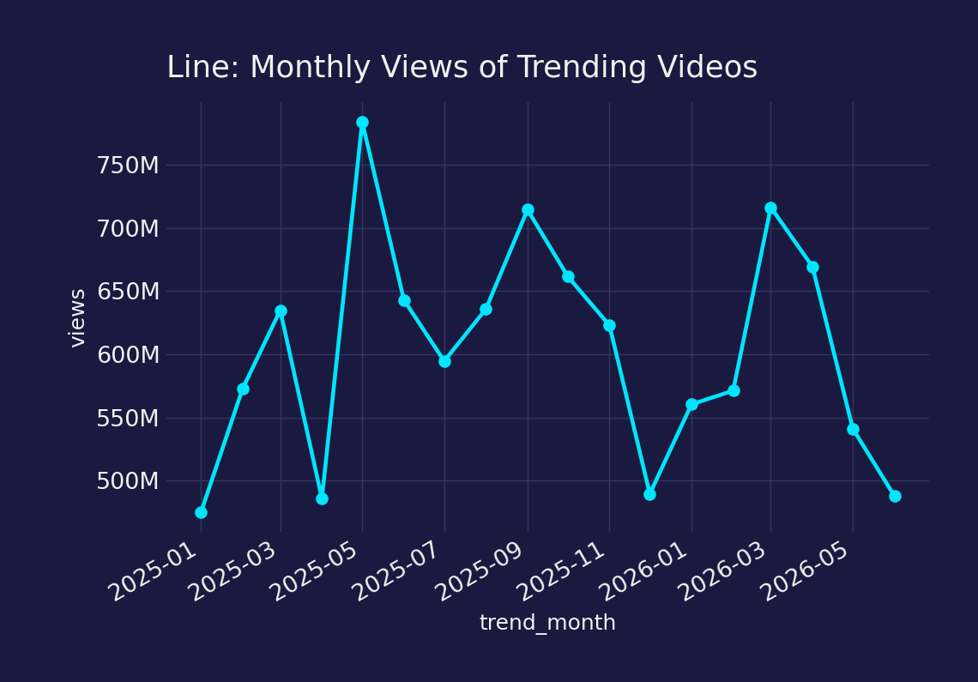
SAMPLE OUTPUT
Charts: Bar, Pie and Line
Bar: total views by category
Pie: videos by channel type
Line: views by month
Read it: longest bar = most-viewed category
Read it: biggest slice = most common channel type
Read it: peaks = months with the most trending views
# Total views per category
bar = f.groupby("category",
as_index=False)["views"].sum()
# Horizontal bar chart
px.bar(bar, x="views",
y="category", orientation="h")
# Share of videos per channel
# tier (small, mid, large, mega)
# hole=0.45 makes it a donut
px.pie(f, names="channel_tier",
hole=0.45)
# Total views per trending month
line = f.groupby("trend_month",
as_index=False)["views"].sum()
# Line chart, marker on each month
px.line(line, x="trend_month",
y="views", markers=True)
DAE • Review-2 • Social Media Data Analysis System
9
Notes:
Three charts are enough to tell the story: the bar chart compares categories, the pie shows the mix of channel types, the line shows the monthly trend. Each is one Plotly Express call on the filtered data.

Slide 10
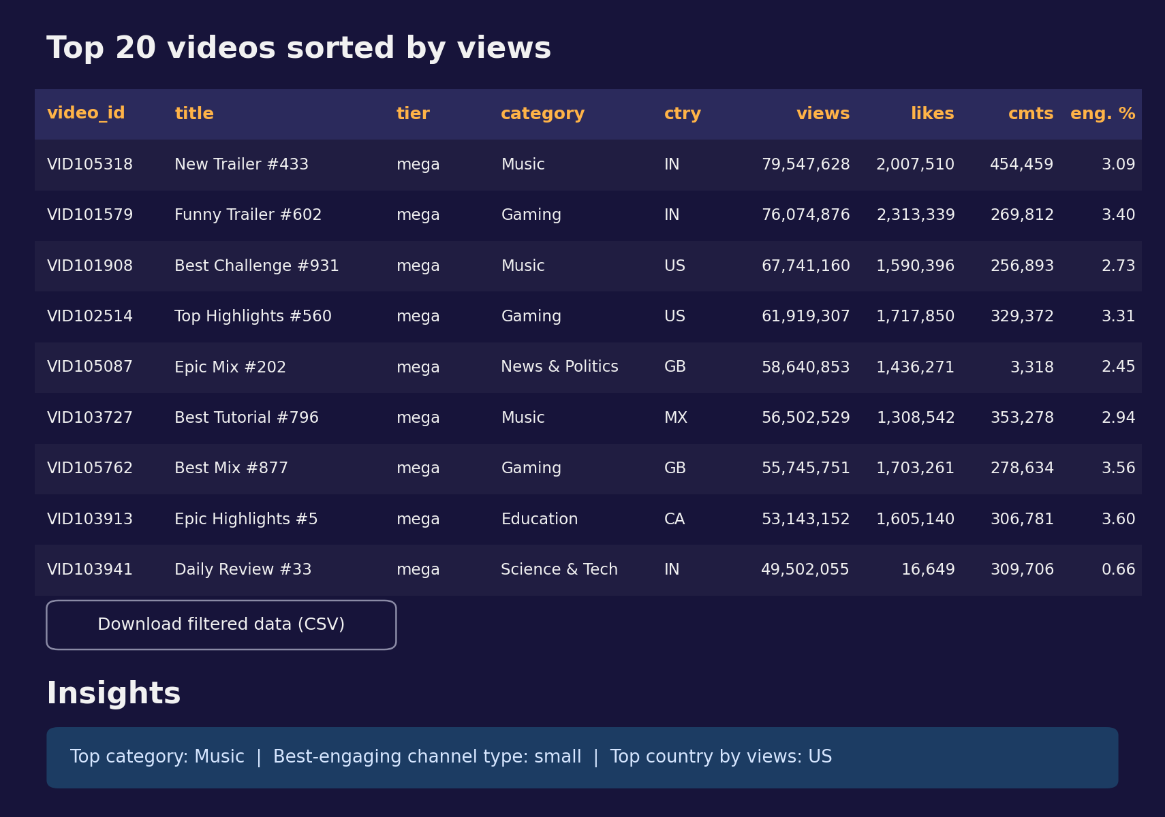
Sorted Table, CSV Download and Insights
SAMPLE OUTPUT
# Sort the filtered data, keep the top N rows
table = (f.sort_values(sort_col,
ascending=ascending)
.head(int(top_n)))
st.dataframe(table[cols], hide_index=True)
# Button: download the filtered data as CSV
st.download_button(
"Download filtered data (CSV)",
f.to_csv(index=False), "filtered_data.csv")
# Insights: top category, tier and country
top_cat = bar.iloc[-1]["category"]
best_tier = (f.groupby("channel_tier")
.engagement_rate.mean().idxmax())
top_country = (f.groupby("country")
.views.sum().idxmax())
Insights box: top category, best-engaging channel type and top country.
DAE • Review-2 • Social Media Data Analysis System
10
Notes:
The table shows the top N videos for the chosen sort column, with a CSV download button. The Insights box reports the top category, the best-engaging channel type and the top country.

Slide 11
Relevant DAE Concepts
Data Collection
Loading the YouTube trending dataset from Excel with Pandas
Preprocessing
Cleaning, standardisation and validation of counts and dates
Feature Engineering
engagement_rate, like_rate, log10_views and trend_month
Visualization
Bar, pie and line charts that update with the filters
Insight Generation
Top category, best-engaging channel type, top country
Programming Concepts
Functions, loops, boolean filtering, groupby and @st.cache_data
DAE • Review-2 • Social Media Data Analysis System
11
Notes:
Map each step to a DAE concept: collection, preprocessing, feature engineering, visualization, insight generation, plus the programming concepts used.

Slide 12
Programming Concepts Used
Functions and caching
clean(), load() and style(); @st.cache_data avoids re-cleaning on every click
Lists and loops
NUM_COLS and DATE_COLS are looped to convert types and fill missing values
NumPy
np.nan for invalid values, np.log10 for view scale, median for filling
Boolean filtering
isin, between and str.contains masks combine all sidebar filters
Group and aggregate
groupby on category, tier, month and country for charts and KPIs
File handling
pathlib Path and to_csv / to_excel save the cleaned data
DAE • Review-2 • Social Media Data Analysis System
21

Slide 13
SUMMARY
Review-2 Key Points
Completed modules: load, clean, transform, filter, dashboard
Cleaned data saved as CSV and Excel in the project folder
Main functions and libraries: Pandas, NumPy, Plotly, Streamlit
Six interactive charts, sorted table and insights
Each step connected to a DAE concept
Each member's individual contribution
LOAD → CLEAN → TRANSFORM → VISUALIZE → INSIGHT
DAE • Review-2 • Social Media Data Analysis System
23

Slide 14
Thank You
Questions?
Notes:
Thank you. We are happy to take questions.

